Slide 1
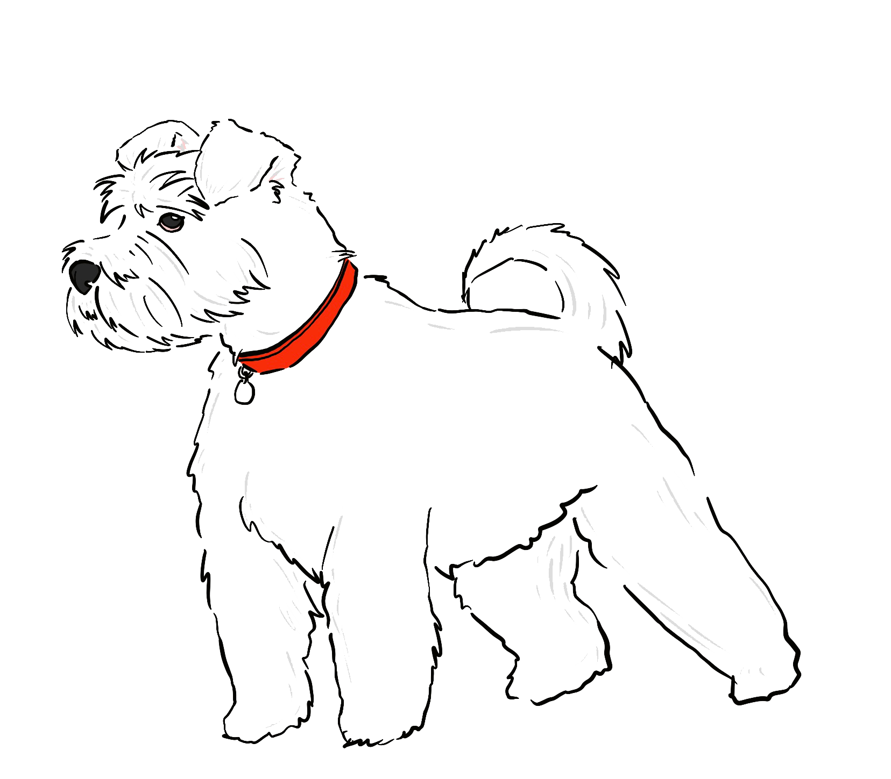

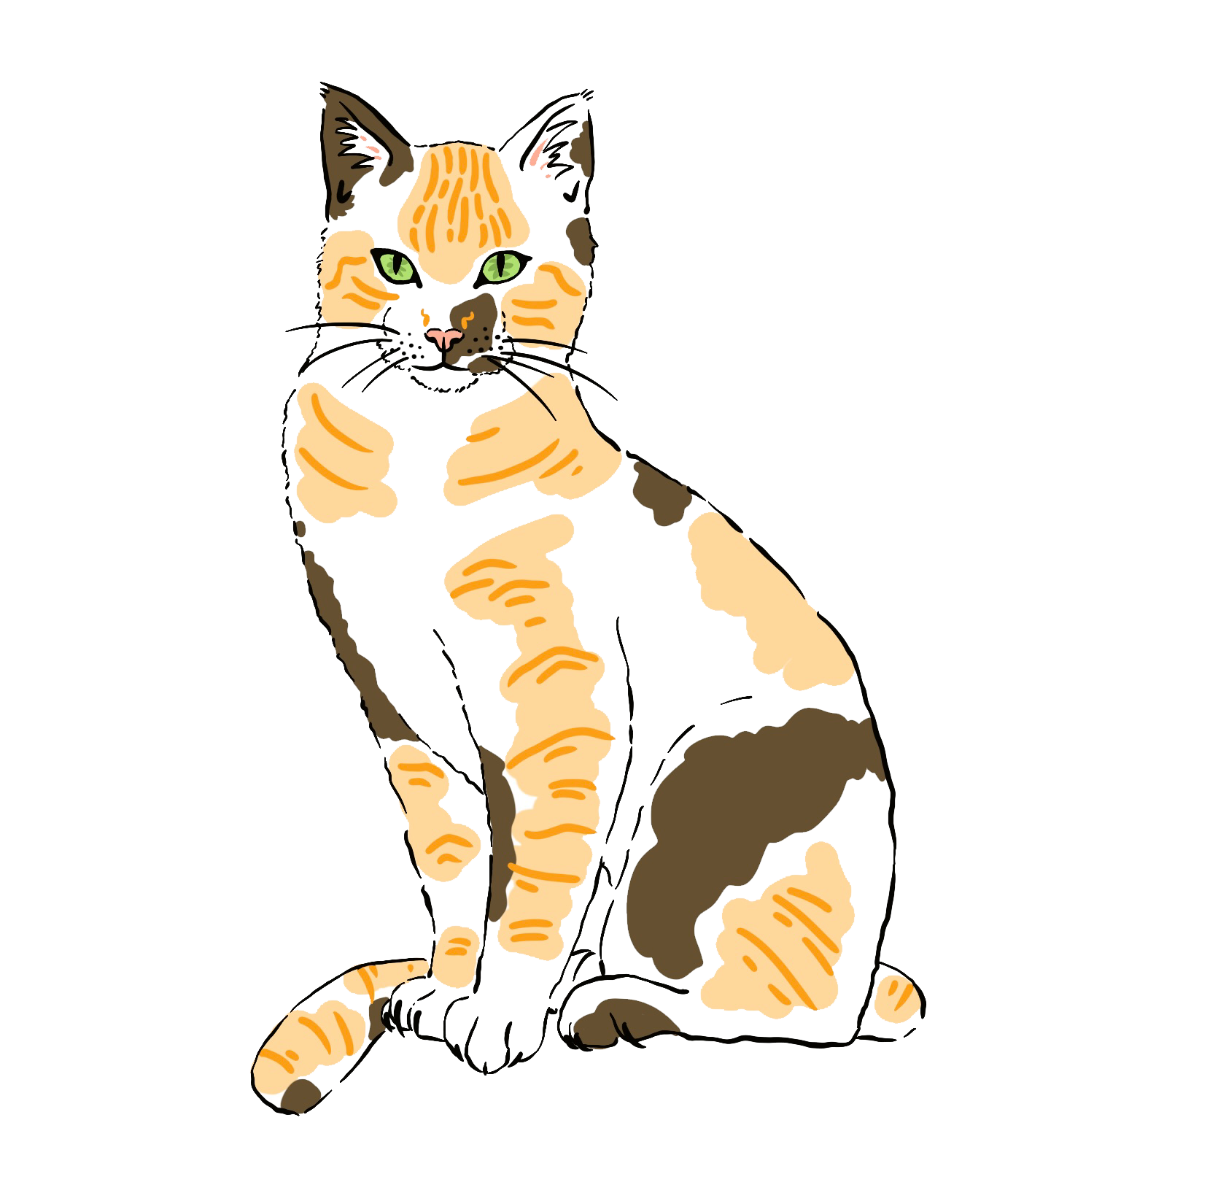
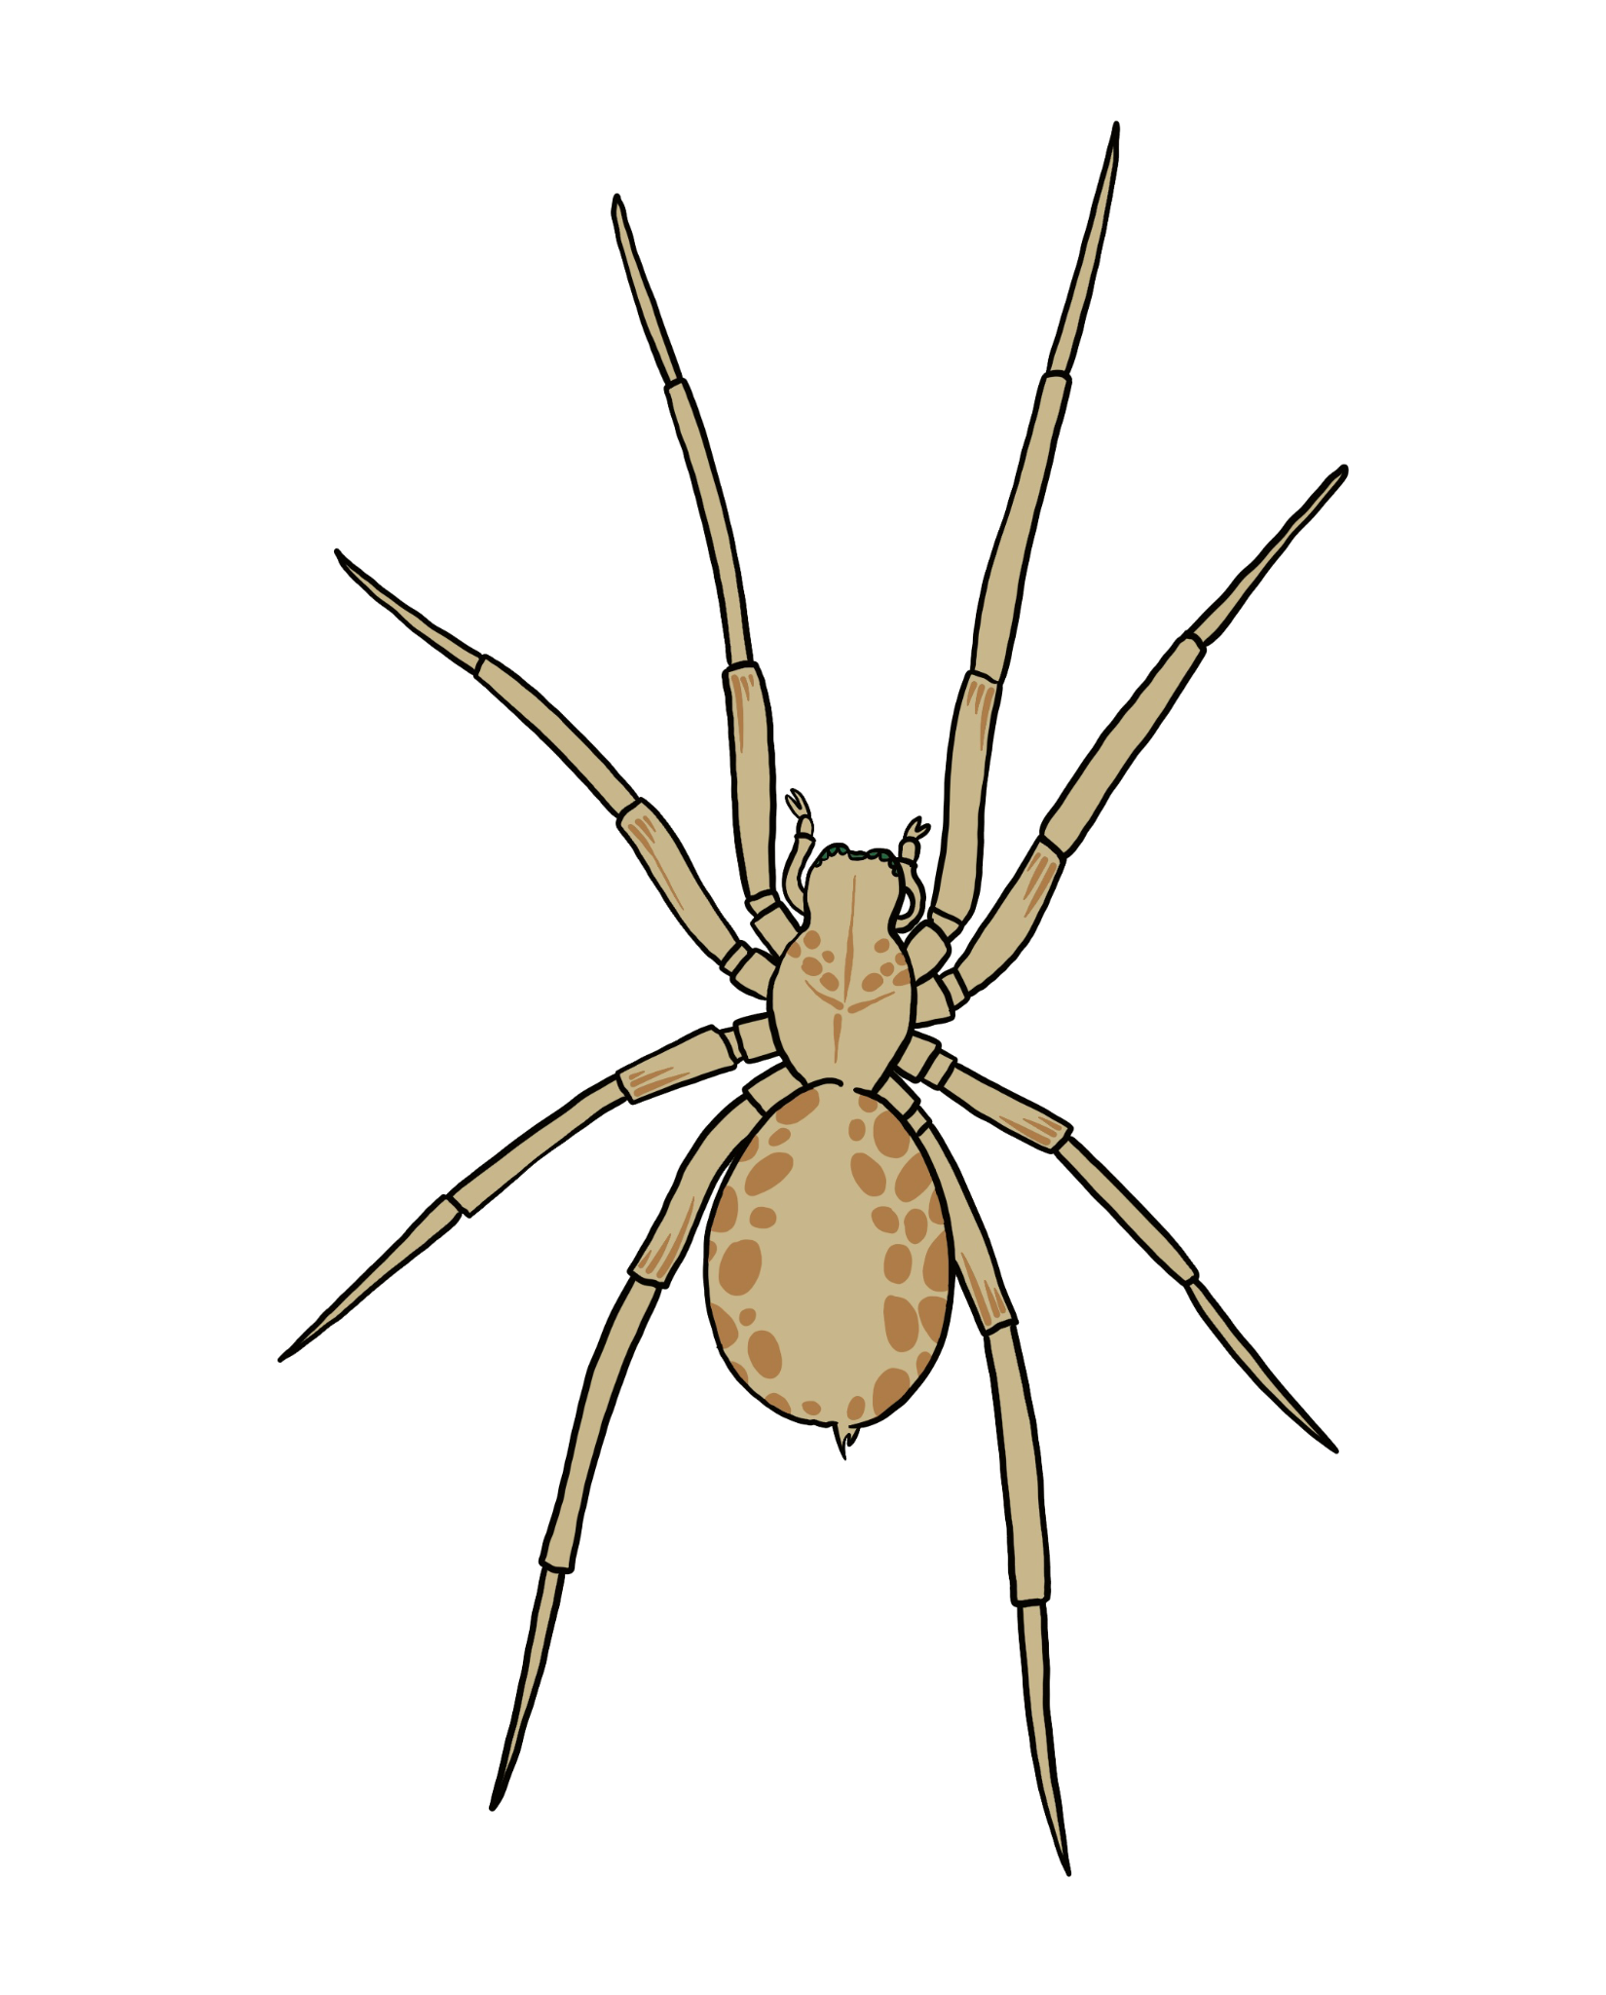
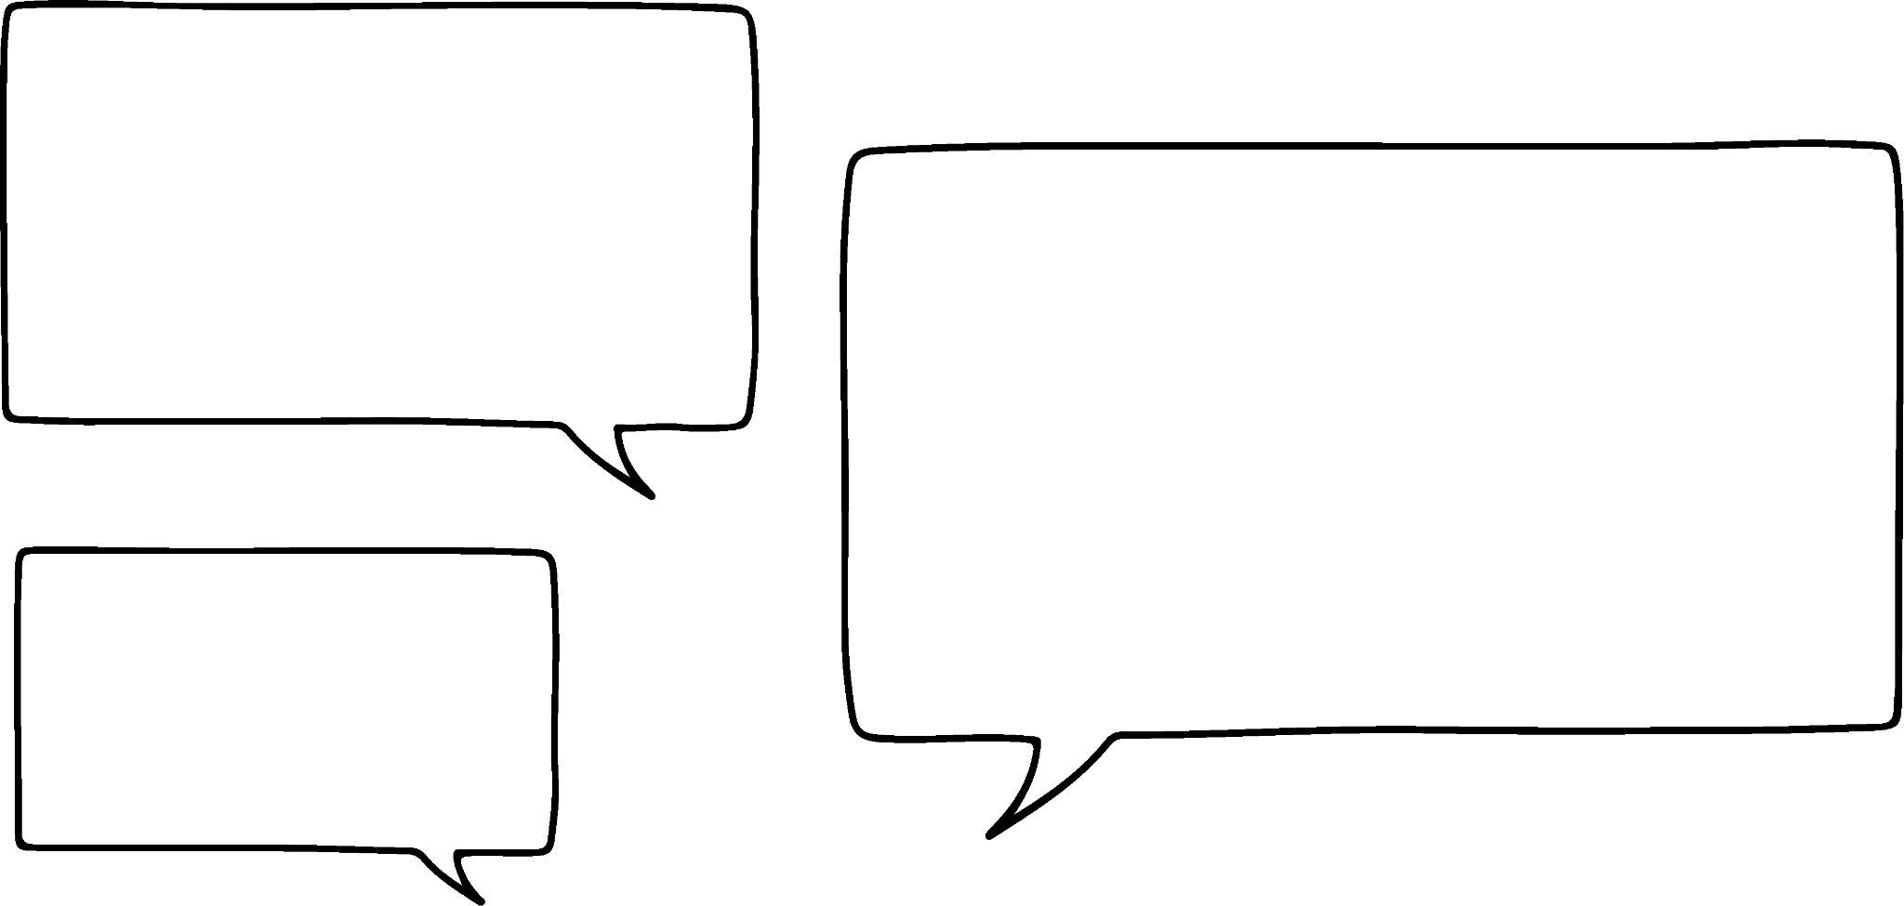

Understanding the mode
Task A: Finding a mode
1) What is the modal animal?
2) In this set of data, what is the mode? 0, 0, 0, 0, 0, 1, 1, 1, 1, 1, 1, 2, 2, 2, 3, 3, 3, 3, 3, 4, 4, 5, 5, 5, 5
3) In this set of data, what is the mode? 12, 16, 18, 12, 19, 18, 15, 16, 18, 19, 12, 12, 18, 15, 18
I rolled a 6 ten times; I rolled a 7 twelve times; I rolled an 8 ten times.
4) Sofia was rolling an eight-sided dice. What was the mode roll on the dice?

Slide 2
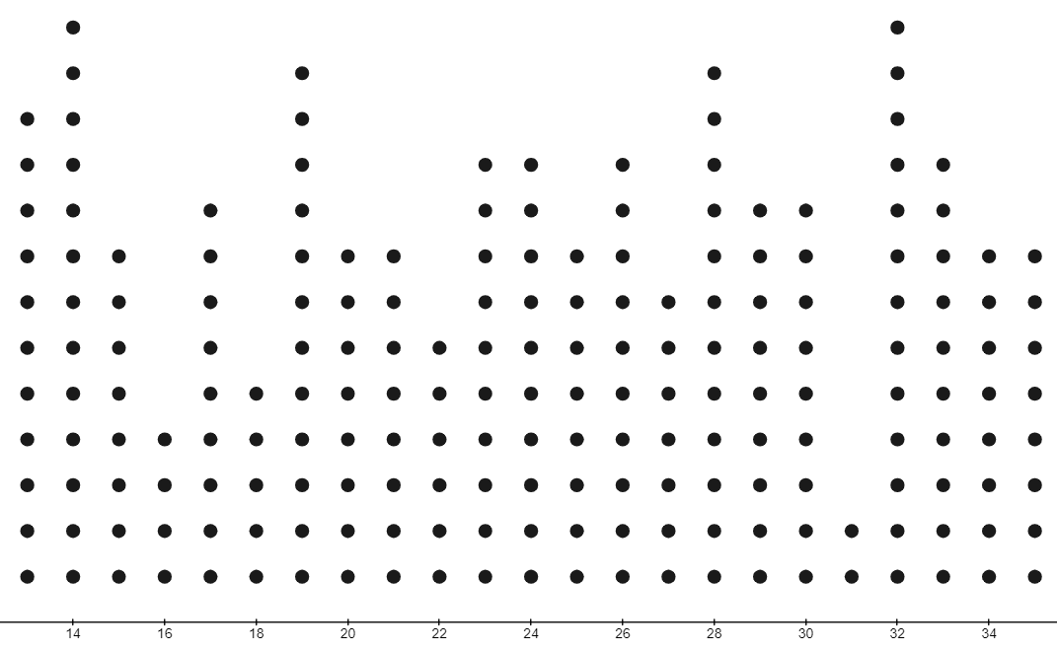
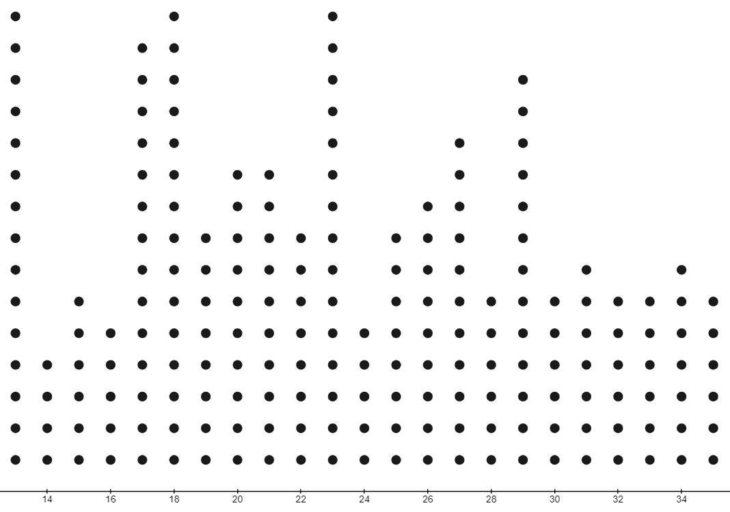
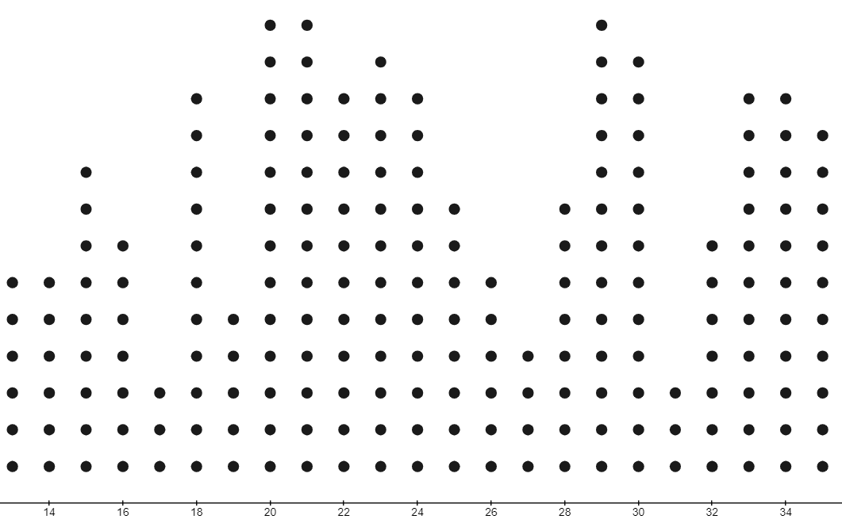
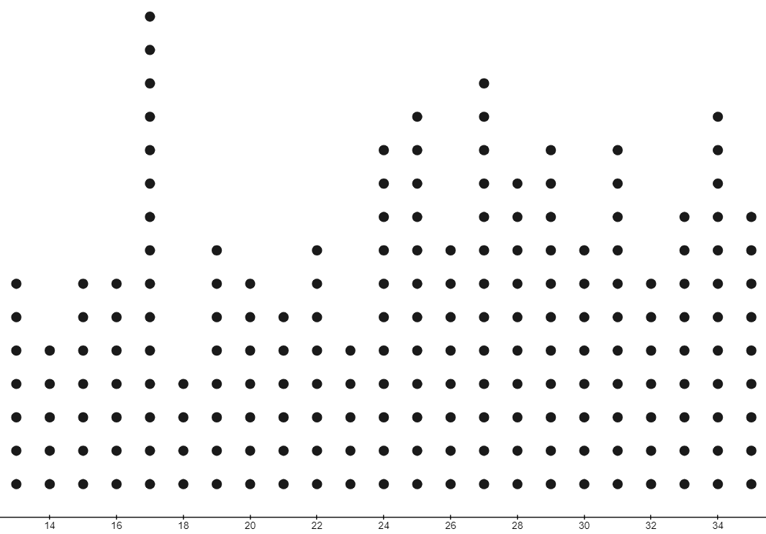
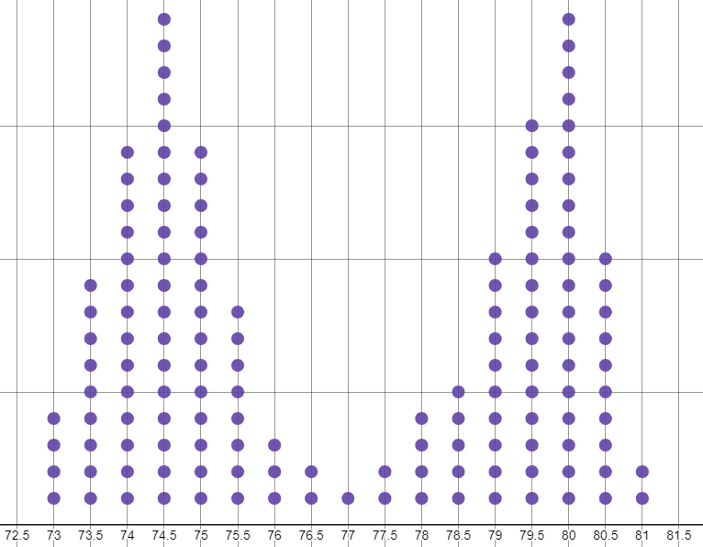
Understanding the mode
Task B: It is not always one mode
1) Write a data set of 20, that is bimodal.
2) Write a data set of 10, that has no mode.
3) Write a data set of 20, that is trimodal.
4) For each data set, write how many modes the data has, if any.
5) What is the mode of the data shown on this dot plot?
Mathematics in Education and Industry
v2.1

